Slide 1
Competitive Cyber Security Organization
Liam's Super Engaging WPA2 Cracking Demo
By attending today’s meeting you acknowledge that you may be photographed or recorded for club use

Slide 2
Safety Disclaimer
We're teaching skills for the purpose of education and protection
If you're going to independently practice any of the skills taught do so on your own hardware; preferably virtualized
The FCC is scary, you can get yourself in serious trouble; know the law

Slide 3
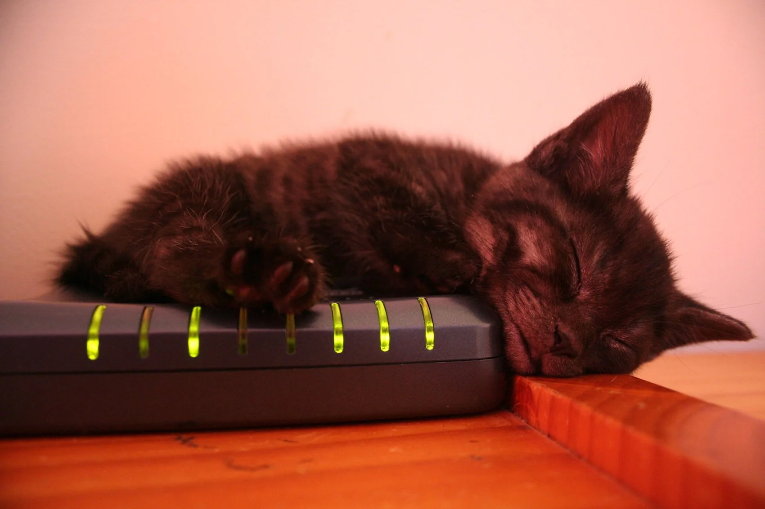
WPA2 Cracking
How do we authenticate to a WiFi Network?
What are some different WiFi security protocols?
How can we leverage these?
His ass is NOT cracking handshakes

Slide 4
Handshakes
Deauthing forces a client to reconnect to a network
Someone listening can leverage this
Offline dictionary attack
Aircrack-ng suite for WPA2-PSK
Will be covered in detail @ RF+WiFi Meeting

